Slide 1

A
Major Project
On
AUTOMATIC GESTURE RECOGNITION AND IMAGE CAPTION GENERATOR
BACHELOR OF TECHNOLOGY
In
COMPUTER SCIENCE AND ENGINEERING
By
B. KAWSHIK (197R1A05K0)
G. SAI MAHESH (197R1A05K9)
M. SAI KUMAR (197R1A05M8)
Under the Guidance of
J . NARASIMHARAO
(Associate Professor)
DEPARTMENT OF COMPUTER SCIENCE AND ENGINEERING
CMR TECHNICAL CAMPUS
UGC AUTONOMOUS
(Accredited by NAAC, NBA, Permanently Affiliated to JNTUH, Approved by AICTE, New Delhi) Recognized Under Section 2(f) & 12(B) of the UGC Act.1956, Kandlakoya (V), Medchal Road, Hyderabad-501401.
2019-2023

Slide 2
ABSTRACT
Caption generation is a difficult synthetic intelligence problem where in a textual description maybe generated for a given photograph.
On every occasion when a photograph seems in front of people, their mind is capable of annotating or labeling it, however how can computer structures procedure and label it with a noticeably relevant and correct caption? So we will train the computers using deep learning algorithms and make it easy.
With advanced deep learning techniques, accessibility of big datasets and computer power we can build an efficient model to generate captions.
The strategies used right here are LSTM(Long Short Term Memory) and CNN(Convolutional Neural Networks).Feature extraction is done first and then captions are generated.
The flickr_8k dataset is used for training the model. The dataset which we are using contains 8000 images and each image is mapped with five different captions
DOMAIN : DEEP LEARNING

Slide 3
EXISTING SYSTEM
Image captioning has gotten a lot of attention recently,especially in the natural language area. The necessity for natural language image descriptions with context is critical.
While this may appear far-fetched, recent advancements in domains like neural networks, computer vision, and natural language processing have paved the path for effectively characterizing images, or capturing their visually grounded meaning.

Slide 4
DISADVANTAGES
Can describe only one single Target object. So that ,we can’t get accurate correct caption.
Not used advance approaches at present .
It only gives caption to single frame.

Slide 5
PROPOSED SYSTEM
The proposed model is to generate the relevant natural language caption to the given input image, instead of just describing a single target object the model detects multiple target objects for generating grammatically correct caption .
We have used flickr_8k data set , the working of the model involves the following steps:
1.The given input image is pre processed.
2. Convolution neural network (CNN) is used to extract features from the provided input image.
3.The information from the CNN is used by the LSTM for generating the relevant caption for the given image.
We're using cutting-edge approaches like Convolutional Neural Networks (CNN) and Recurrent Neural Networks (RNN), as well as associated image and human perceived description datasets, to do this. We show that our alignment approach works in retrieval tests on datasets like Flickr.

Slide 6
ADVANTAGES
In this project, instead of just describing a single target object, this model detects multiple target objects and generating grammatically correct caption.
Higher accuracy &stability.
Quicker time to unlock a device.
Can convey a range of Accurate emotions.

Slide 7
HARDWARE REQUIRMENTS
Processor – i5 and above (64-bit OS).
Memory – 4GB RAM (Higher specs are recommended for high performance).
Input devices – Keyboard, Mouse

Slide 8
SOFTWARE REQUIRMENTS
Windows/Mac .
Kaggle Notebook
Python3
CNN and LSTM algorithm
NumPy, Keras ,TensorFlow libraries

Slide 9
NOVELTY
In this project, instead of just describing a single target object, this model detects multiple target objects for generating grammatically correct caption.
So, we can definitely save our time in recognizing the gesture .
We have used wide ranging applications of CNN and LSTM

Slide 10
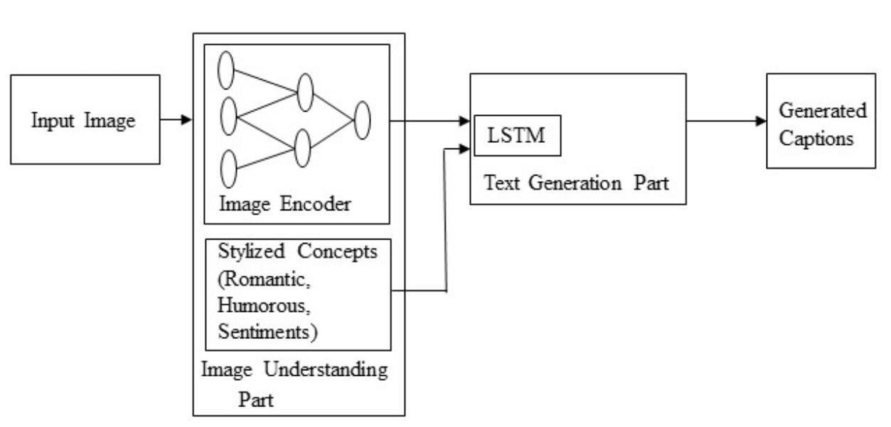
ARCHITECTURE

Slide 11
MODULE
Types of Logins : User, Trainer.
User Process : User gives input as an image.
Flicker 8k Dataset : It is a training model in Deep learning.
CNN algorithm: It exact the feature from the image.
LSTM algorithm : Data available in CNN algorithm ,by using this data it gives the relavent captioning for the given image.
Execution model : By using flicker 8k dataset and two wide range Algorithms, CNN and LSTM, will help us to produce the captioning of an image.

Slide 12
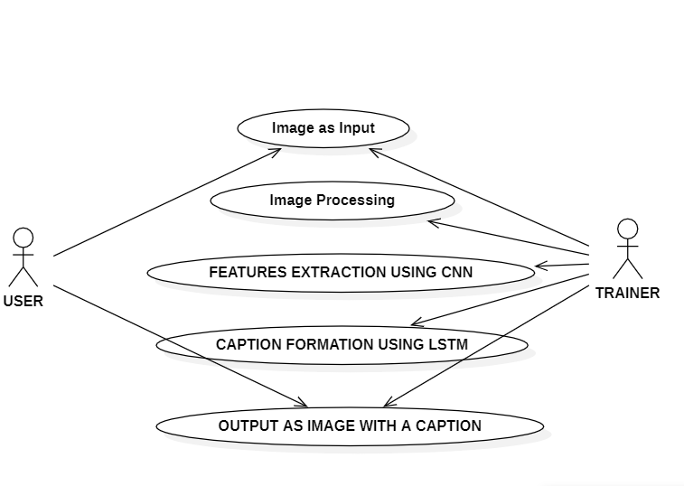
UML DIAGRAMS
USE CASE DIAGRAM :-

Slide 13
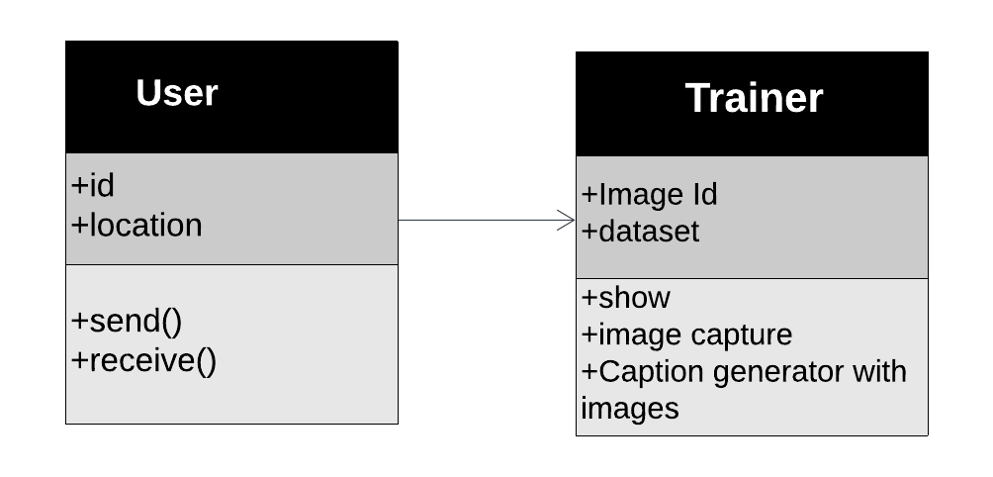
CLASS DIAGRAM:
1
1
1

Slide 14
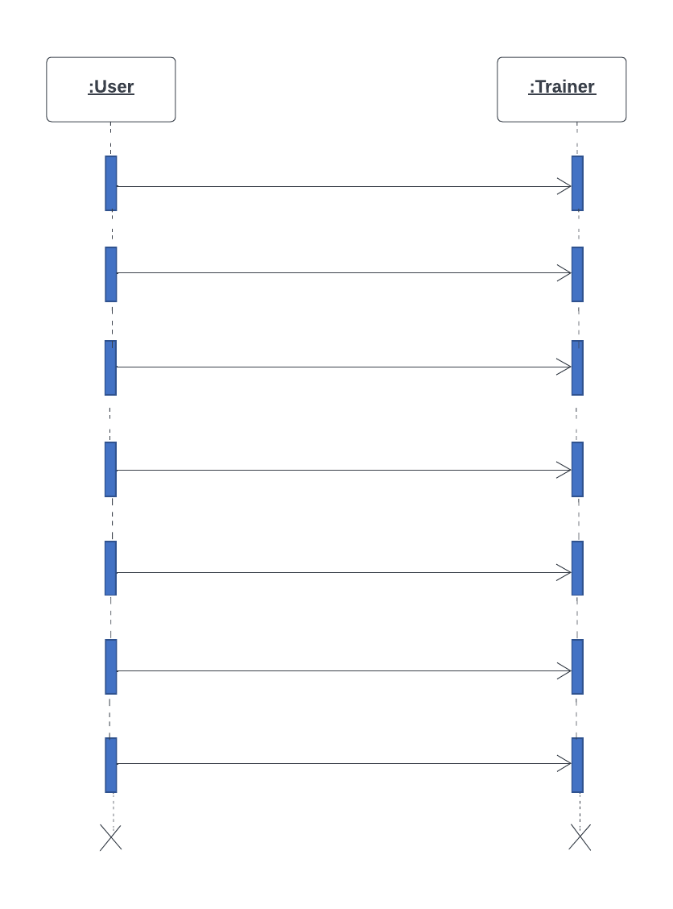
SEQUENCE DIAGRAM:
1.Import Libraries
2.Load Image Dataset
3.Data Processing
4.Feature Extraction
5.Run open cv
6.Captures image with text
7. Displays the caption to User

Slide 15
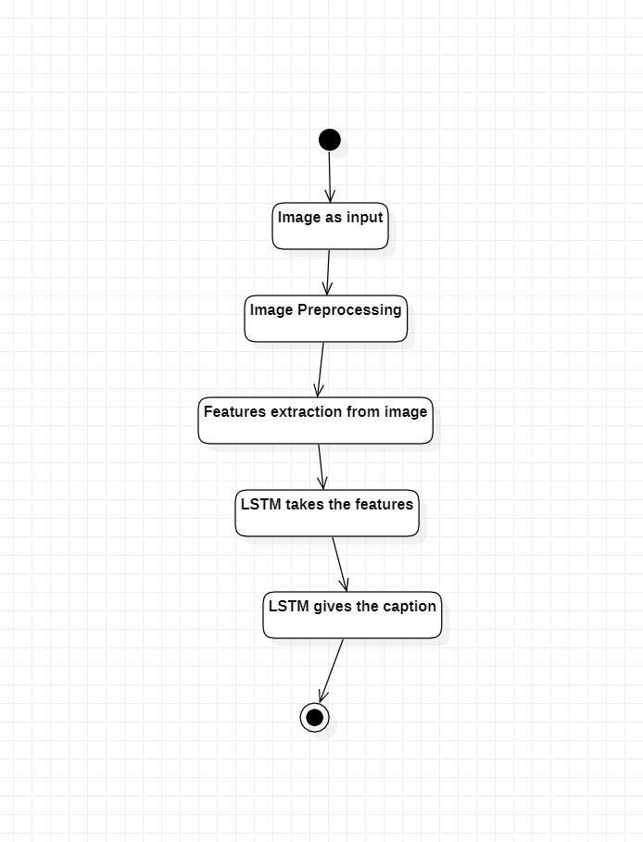
ACTIVITY DIAGRAM:

Slide 16
Source Code:-
1)import os
import pickle
import numpy as np
from tqdm.notebook import tqdm
from tensorflow.keras.applications.vgg16 import VGG16, preprocess_input
from tensorflow.keras.preprocessing.image import load_img, img_to_array
from tensorflow.keras.preprocessing.text import Tokenizer
from tensorflow.keras.preprocessing.sequence import pad_sequences
from tensorflow.keras.models import Model
from tensorflow.keras.utils import to_categorical, plot_model
from tensorflow.keras.layers import Input, Dense, LSTM, Embedding, Dropout, add
2)BASE_DIR = '/kaggle/input/flickr8k'
WORKING_DIR = '/kaggle/working'
Extract Image Features
3)# load vgg16 model
model = VGG16()
# restructure the model
model = Model(inputs=model.inputs, outputs=model.layers[-2].output)
# summarize
print(model.summary())

Slide 17
4)features = {}
directory = os.path.join(BASE_DIR, 'Images')
for img_name in tqdm(os.listdir(directory)):
# load the image from file
img_path = directory + '/' + img_name
image = load_img(img_path, target_size=(224, 224))
# convert image pixels to numpy array
image = img_to_array(image)
# reshape data for model
image = image.reshape((1, image.shape[0], image.shape[1], image.shape[2]))
# preprocess image for vgg
image = preprocess_input(image)
# extract features
feature = model.predict(image, verbose=0)
# get image ID
image_id = img_name.split('.')[0]
# store feature
features[image_id] = feature
5)pickle.dump(features, open(os.path.join(WORKING_DIR, 'features.pkl'), 'wb'))

Slide 18
6)with open(os.path.join(WORKING_DIR, 'features.pkl'), 'rb') as f:
features = pickle.load(f)
Load the Captions Data
7)with open(os.path.join(BASE_DIR, 'captions.txt'), 'r') as f:
next(f)
captions_doc = f.read()
8)mapping = {}
# process lines
for line in tqdm(captions_doc.split('\n')):
# split the line by comma(,)
tokens = line.split(',')
if len(line) < 2:
continue
image_id, caption = tokens[0], tokens[1:]
# remove extension from image ID
image_id = image_id.split('.')[0]
# convert caption list to string
caption = " ".join(caption)
# create list if needed
if image_id not in mapping:
mapping[image_id] = []
# store the caption
mapping[image_id].append(caption)

Slide 19
9)len(mapping)
10)def clean(mapping):
for key, captions in mapping.items():
for i in range(len(captions)):
# take one caption at a time
caption = captions[i]
# preprocessing steps
# convert to lowercase
caption = caption.lower()
# delete digits, special chars, etc.,
caption = caption.replace('[^A-Za-z]', '')
# delete additional spaces
caption = caption.replace('\s+', ' ')
# add start and end tags to the caption
caption = 'startseq ' + " ".join([word for word in caption.split() if len(word)>1]) + ' endseq'
captions[i] = caption\
11)mapping['1000268201_693b08cb0e']
12)clean(mapping)
13)mapping['1000268201_693b08cb0e']
14)all_captions = []
for key in mapping:
for caption in mapping[key]:
all_captions.append(caption)
15)len(all_captions)
16)all_captions[:10]

Slide 20
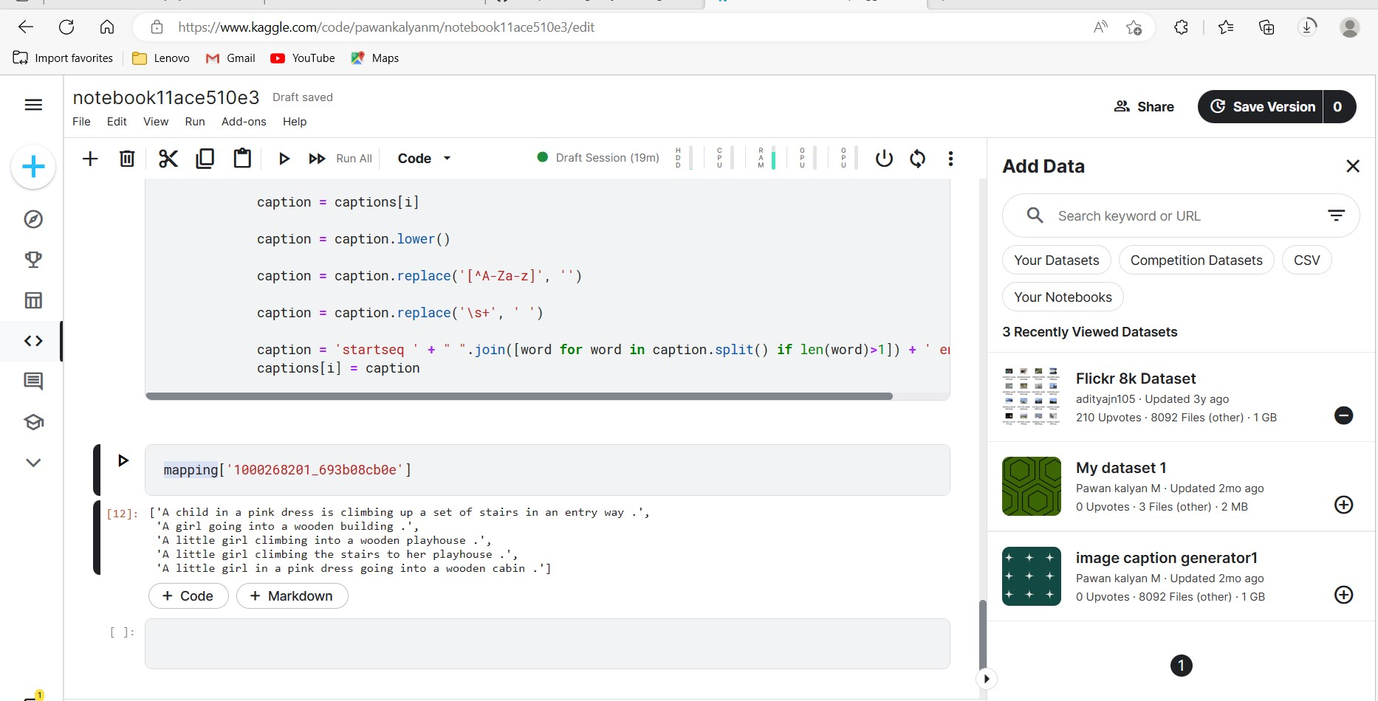
SCREENSHOTS(RESULT)
pre-processing text data

Slide 21
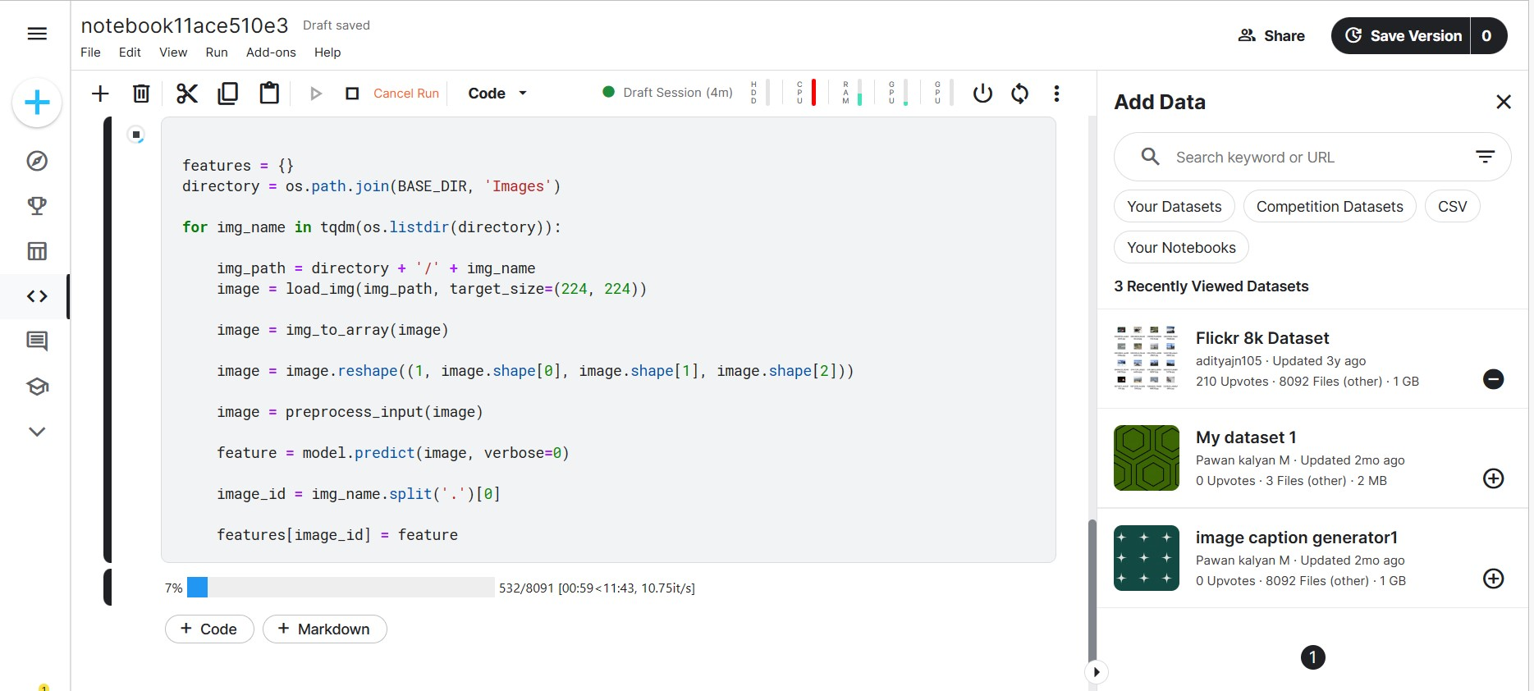
Extacting images

Slide 22
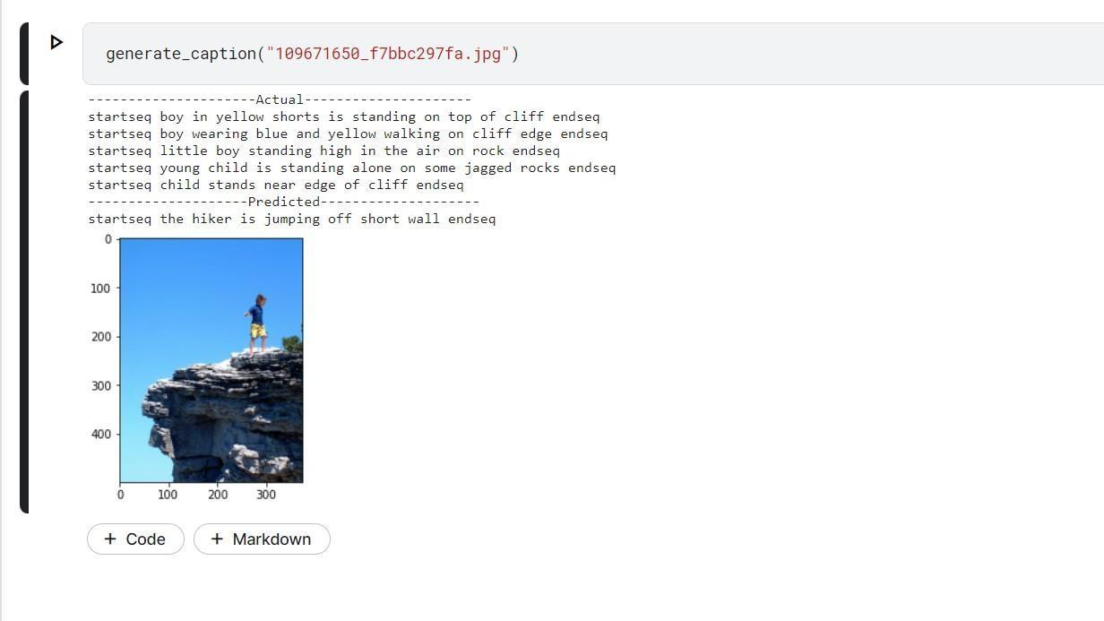
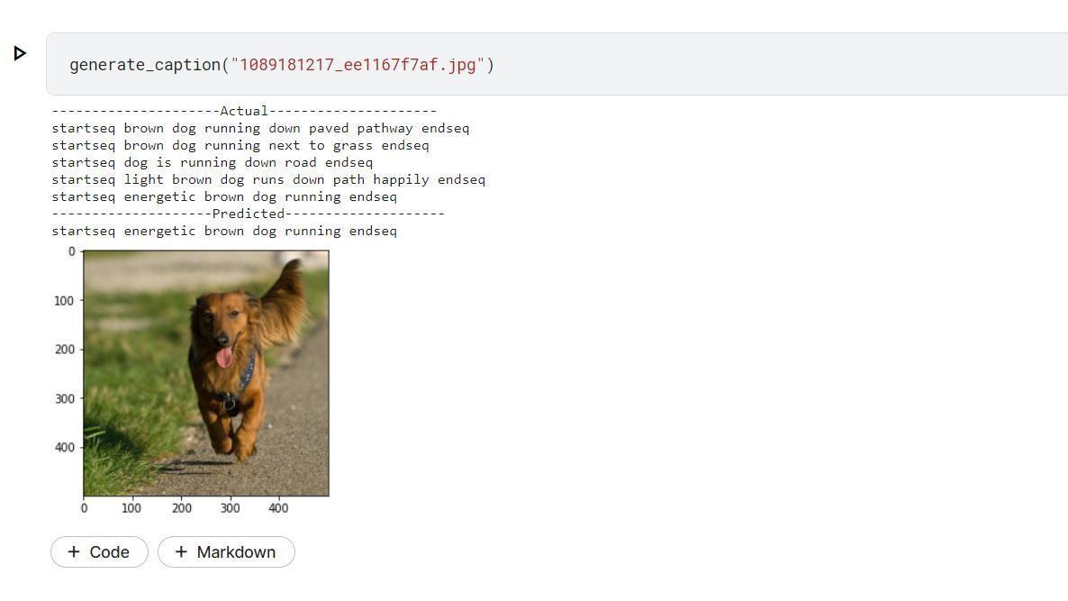
Generating Captions

Slide 23
CONCLUSION
In this work , we have Generated several appropriate and grammatically correct caption in a natural language like a human is a difficult task ,this task involves feature extraction and natural language processing concepts.
The data set that has been used for this model is flickr_8k data set which consists around eight thousand images, for the given image the context of the image is recognized by targeting multiple objects.
We have used wide ranging applications of CNN and LSTM .
As the users are increasing day by day the image captioning has a vast scope in the future, the model is built over a dataset of eight thousand images to improve the accuracy and performance this can be implemented on the higher dataset.

Slide 24
FUTURE ENHANCEMENTS
Image captioning is used in many applications including Google photos, Skin vision, Adobe photoshop, social media etc.
It has recently become a significant issue, and we have explored several image generating strategies in the past, understand the process of image extraction and addressed the challenges faced by them, to improve the accuracy by extracting the features of the context of the image larger data set can be used.
This project can be enhanced in the future by using CPUs and GPUs for achieving faster, cheaper and efficient algorithms, instead of limiting to the one language i.e , English the caption can be generated in different languages as required by the user.

Slide 25
REFERENCES
[1] S. ALBAWI and T. A. MOHAMMED, "Understanding of a Convolutional Neural Network,"in ICET, Antalya, 2017.
[2] S. Hochreiter, "LONG SHORT-TERM MEMORY," Neural Computation, December 1997.
[3] O. Vinyals, A. Toshev, S. Bengio and D. Erhan,"A Neural Image Caption Generator," CVPR 2015 Open Access Repository, vol. Xiv, 17 November 2014.
[4] D. S. Whitehead, L. Huang, H. and S.-F. Chang, "Entityaware Image CaptionGeneration,"inEmpirical Methods in Natural Language Processing, Brussels, 2018.
[5] C. Elamri and T. Planque, "Automated Neural Image Caption Generator for Visually Impaired People," California, 2016.
[6] G. Ding, M. Chen, S. Zhao, H. Chen, J. Han and Q. Liu, "Neural Image Caption Generation with
Weighted Training and Reference," Cognitive Computation, 08 August 2018.

Slide 26
GITHUB LINK
https://github.com/kawshikbhyroju/Major-Project

Slide 27
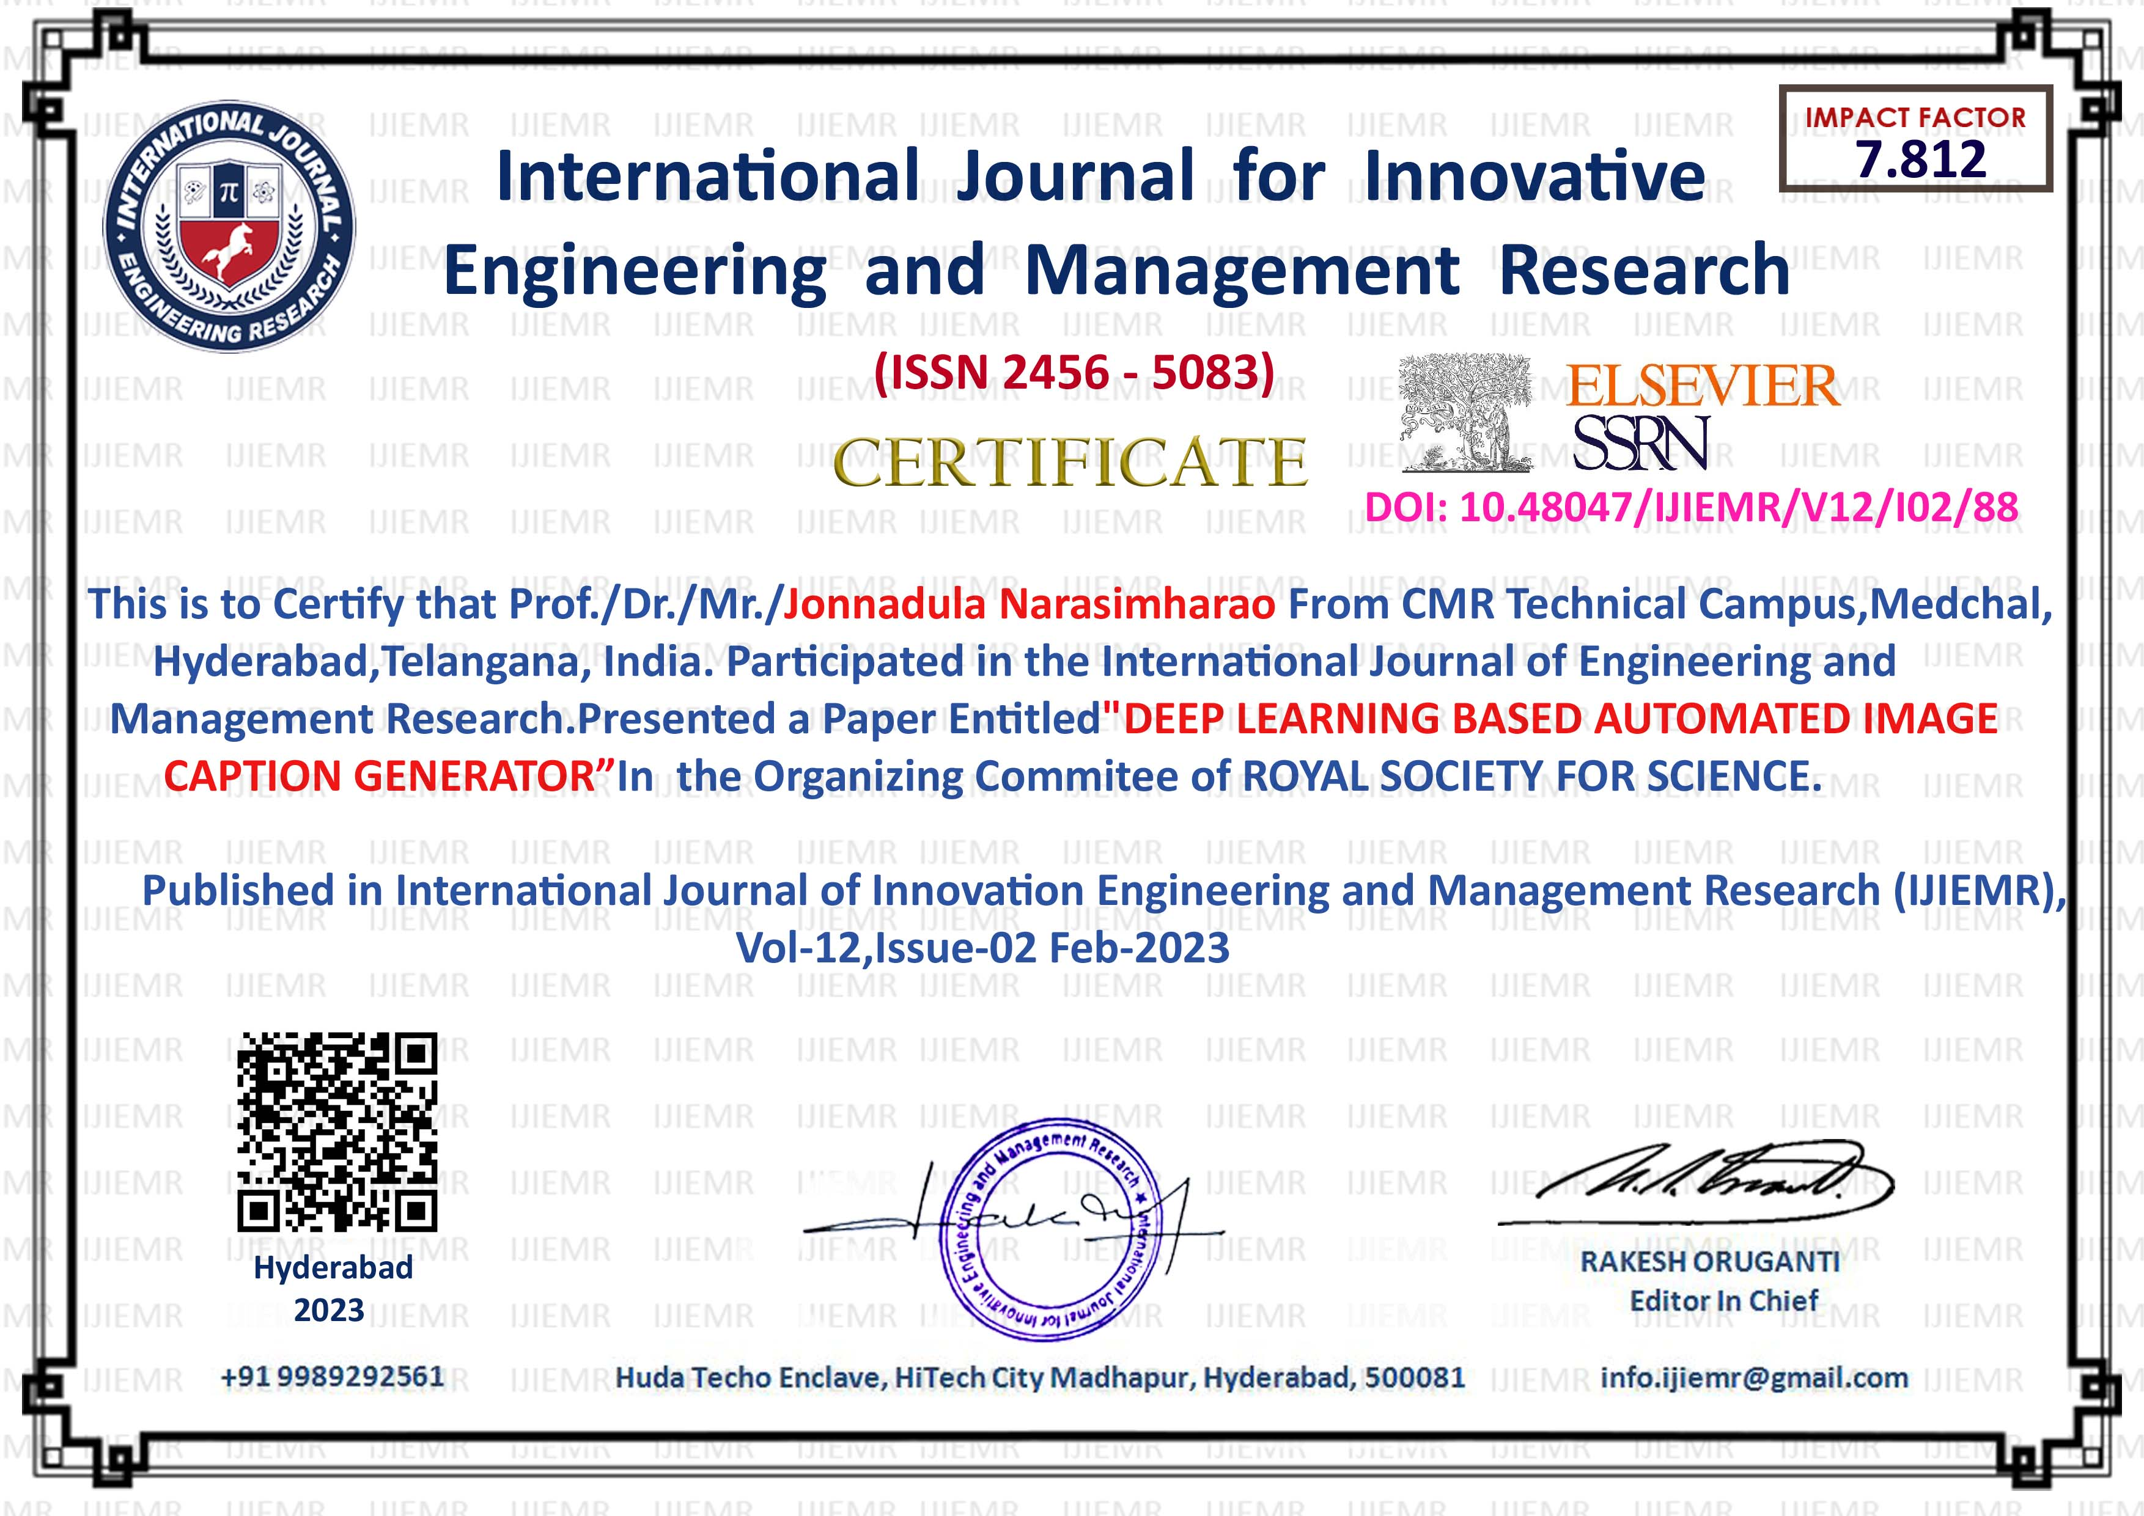
CERTIFICATES

Slide 28
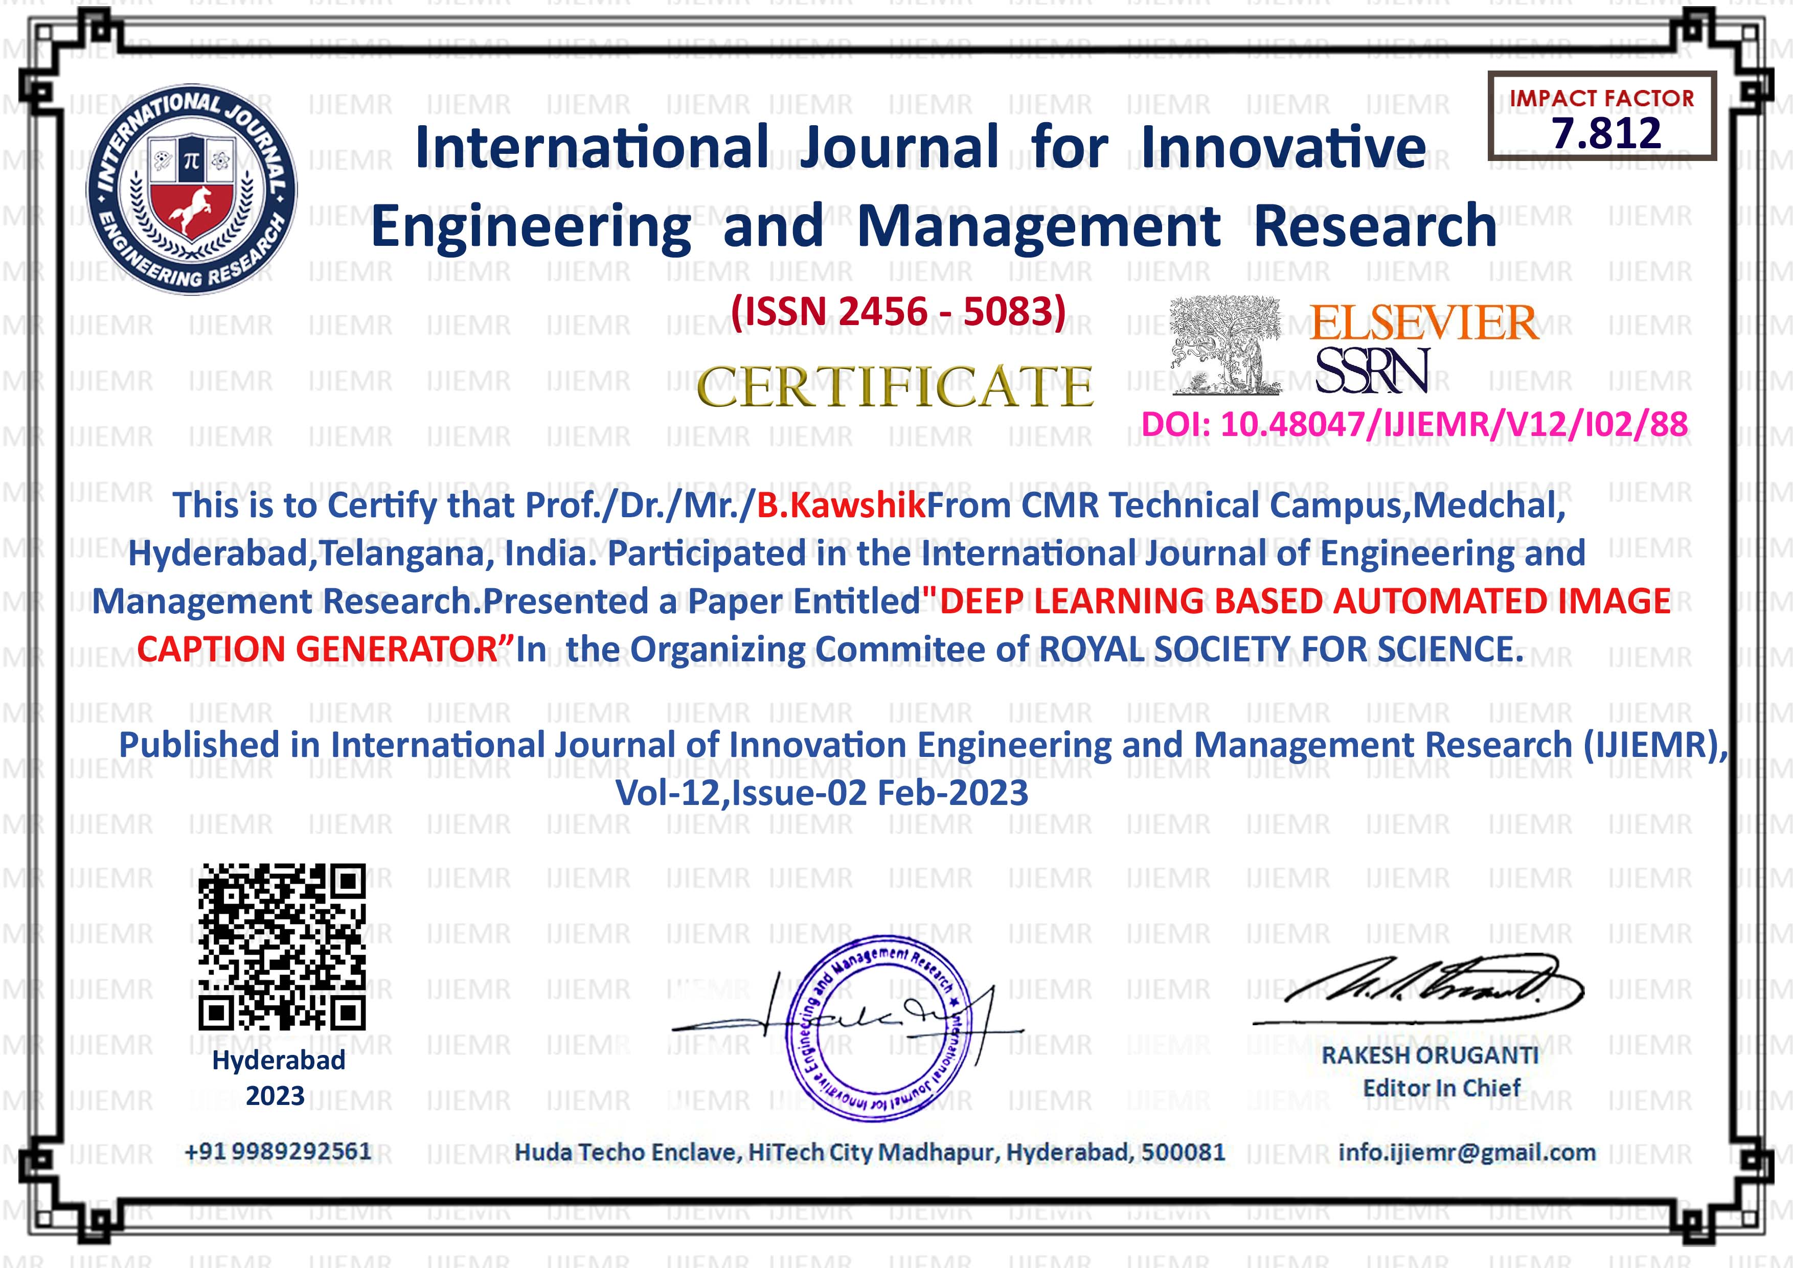

Slide 29
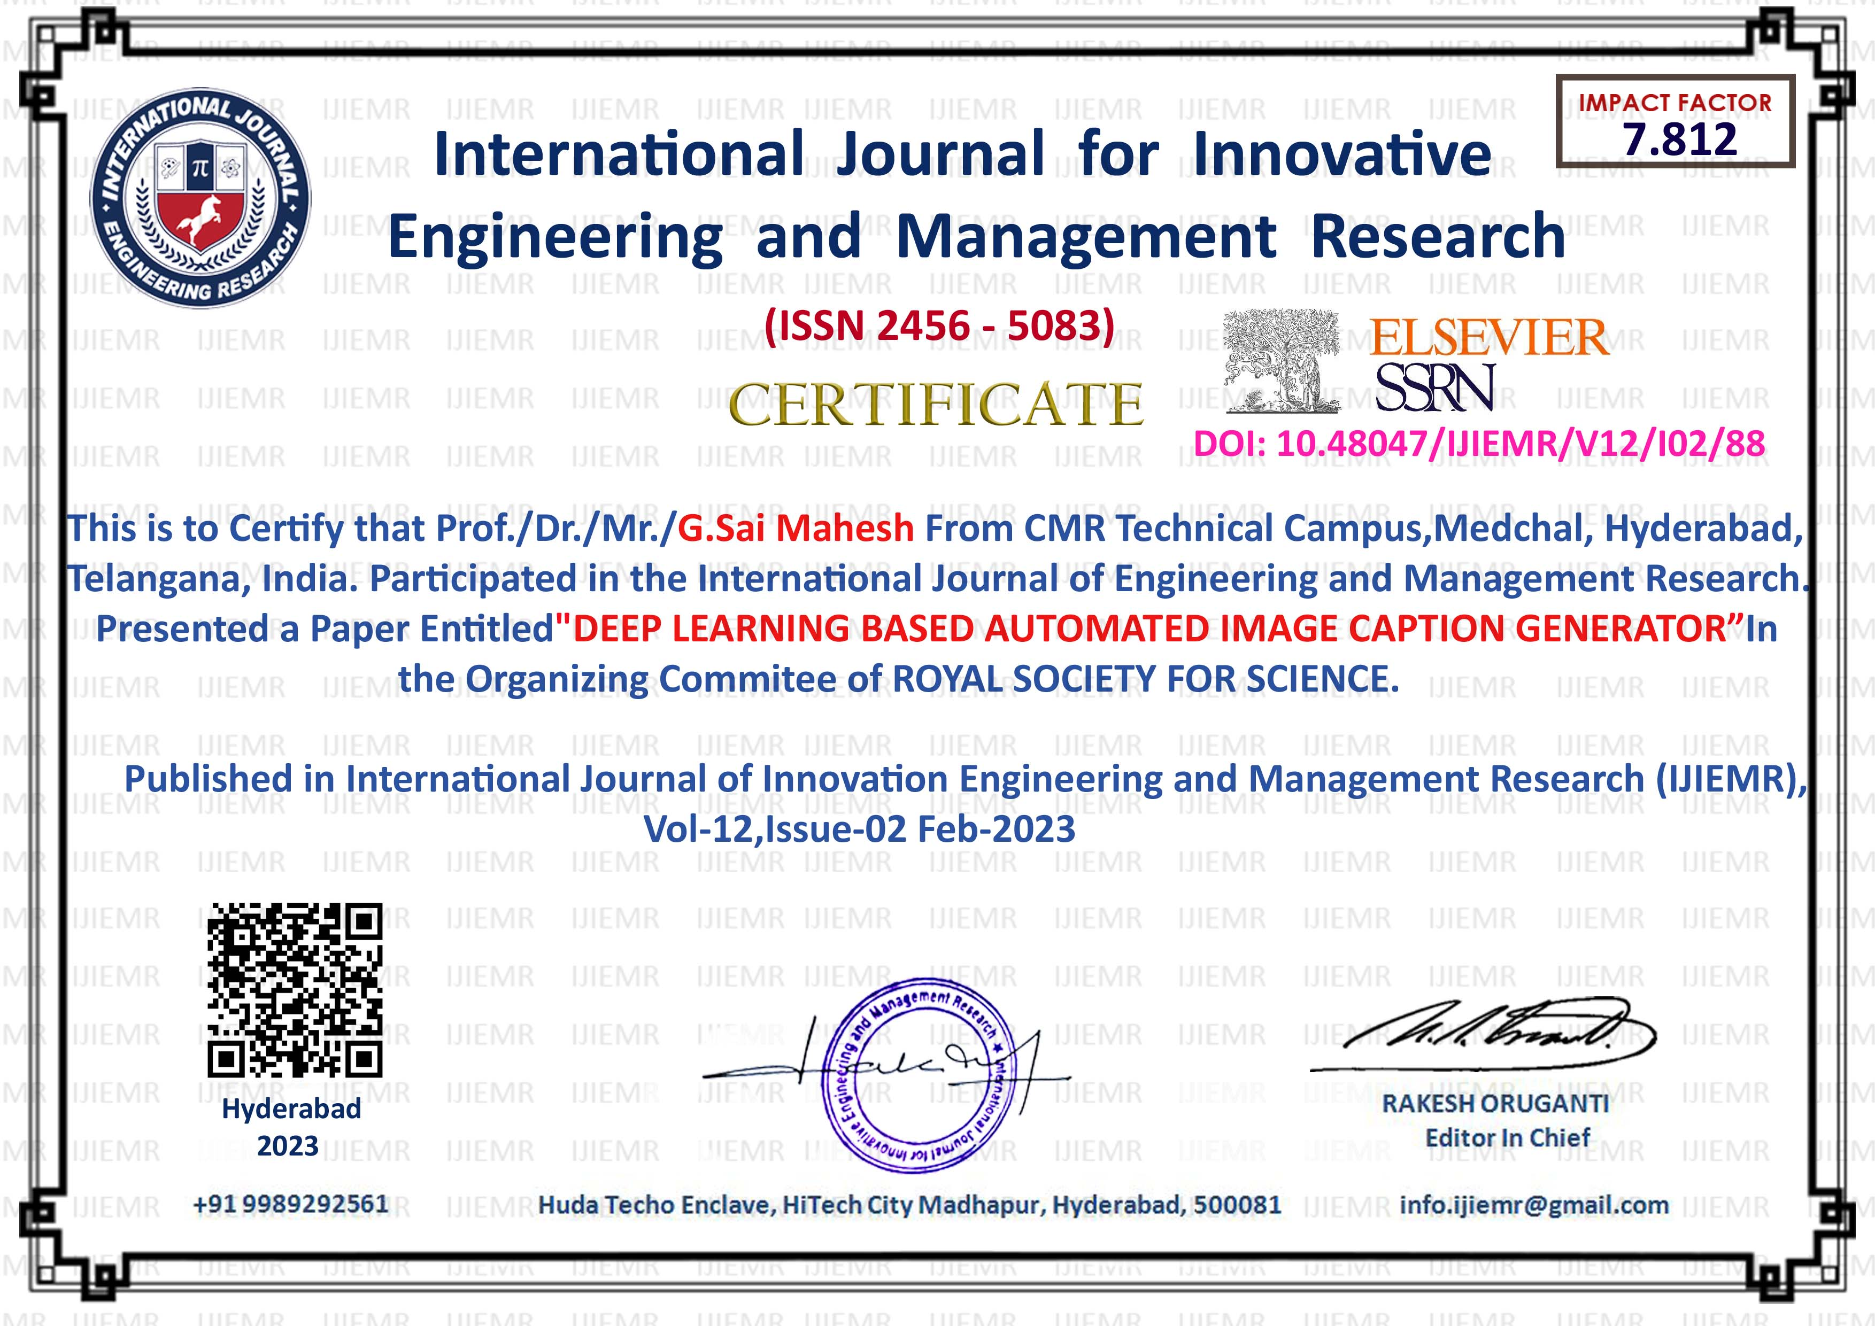

Slide 30


Slide 31
THANK YOU

